Slide 1


Fraud Detection Product Overview
BDM3014 – Artificial Intelligence
Group 3

Slide 2


Enhancing Fraud Detection through Model Interpretability and Tuning
In the realm of fraud detection, where accuracy is paramount, understanding how models arrive at decisions is as crucial as optimizing their performance.
Today, we'll delve into why interpretability matters and how tuning can elevate fraud detection models to new heights.

Slide 3
XGBoost Model Evaluation and Feature Selection Before Tuning
1. Run the Default Model (All Independent Variables):
Trained the default XGBoost model using all independent variables (#218).
Train AUC: 0.967, Test AUC: 0.885.
Extracted feature importances.
2. Default Model with Top 100 Important Features:
Ran the default XGBoost model using the top 100 important features.
Train AUC: 0.965, Test AUC: 0.89.
3. Default Model with Top 50 Important Features:
Executed the default XGBoost model using the top 50 important features.
Train AUC: 0.959, Test AUC: 0.88.
4. Final Default Model with 46 Features:
Identified and extracted unnecessary dummy variables associated with the same categorical variable.
Final default XGBoost model was trained with 46 independent variables selected.
Train AUC: 0.959, Test AUC: 0.88.
** Scale_pos_weight parameter used even in the default models due to the imbalanced nature of the data.

Slide 4
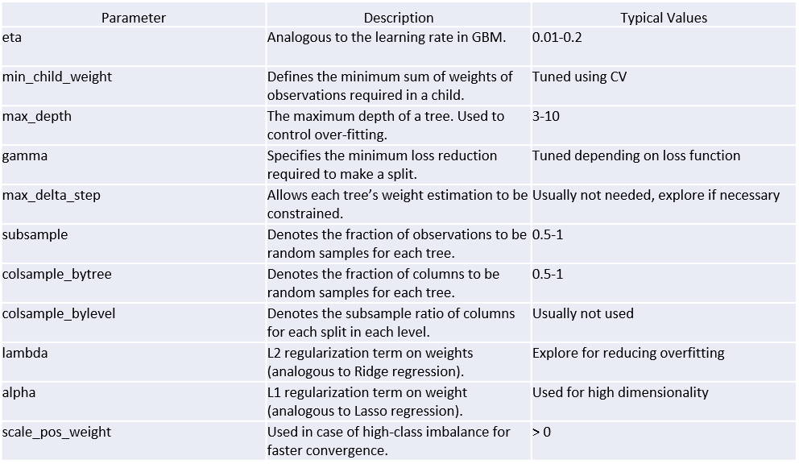
What are XGBoost Parameters?
Booster Parameters
The overall parameters have been divided into 3 categories by XGBoost authors:
General Parameters: Guide the overall functioning of XGBoost Model (booster [default=gbtree], n_jobs etc.)
Booster Parameters: Guide the individual booster (tree/regression) at each step.
Learning Task Parameters: Guide the optimization performed during the learning task (objective, eval_metric etc.)

Slide 5
LightGBM Model Evaluation and Feature Selection Before Tuning
1. Run the Default Model (All Independent Variables):
Trained with the LightGBM default model parameters using all independent variables (#218).
Train AUC: 0.95, Test AUC: 0.89.
2. Second Model with Optimized Parameters:
Ran the default LightGBM model using the optimized features.
Train AUC: 0.99, Test AUC: 0.89.
3. Third Model with Top 50 Important Features:
Executed the optimized LightGBM model using the top 50 important features.
Train AUC: 0.97, Test AUC: 0.87.
4. Final Tunned Model with 50 Features:
Final LightGBM model was trained with 50 independent features selected.
Train AUC: 0.92, Test AUC: 0.88.
** Scale_pos_weight parameter used even in the default models due to the imbalanced nature of the data.

Slide 6
Cross Validation & Hyperparameter Tuning
Choosing Initial Parameters:
Start with a relatively high learning rate, typically around 0.1.
Use the "cv" function in XGBoost to determine the optimal number of trees(n_estimators) through cross-validation.
Implement early stopping based on AUC performance. For example, if the AUC does not improve for 50 iterations, training stops, and the model uses the best iteration.
Tuning Tree-Specific Parameters:
Focus on tuning tree-specific parameters such as max_depth, min_child_weight, gamma, subsample, and colsample_bytree for the chosen learning rate and number of trees.
Tuning Regularization Parameters:
Optimize regularization parameters (lambda, alpha) to control model complexity and enhance performance. This step contributes to preventing overfitting.
Lowering the Learning Rate:
Decrease the learning rate and fine-tune other parameters while considering the findings from the previous steps. Lowering the learning rate allows for a more refined model.

Slide 7





Deployment: Technologies
Cloud PaaS
Web Server
Website
User interface
Request / Response API Rest Service
Input fields configurations
Python framework for API REST Service
Log of input parameters and result predictions

Slide 8
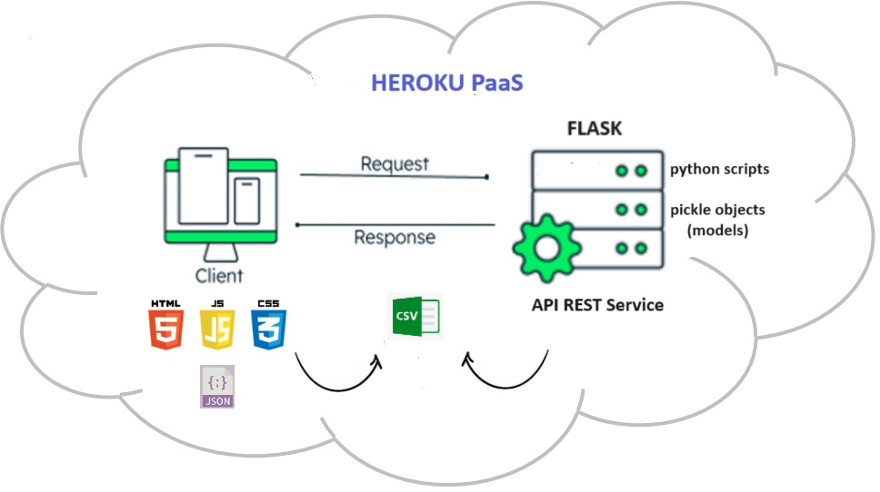
Deployment: Architecture

Slide 9
Demo

